Slide 1


Team 54: ECEN 215 Lab Kit
Bi-Weekly Update 1 Gavin Bernard, Maylun Huang, Evan Slyter Sponsor: Professor Lusher TA: Hailey Ward
Notes:
Michelle

Slide 2
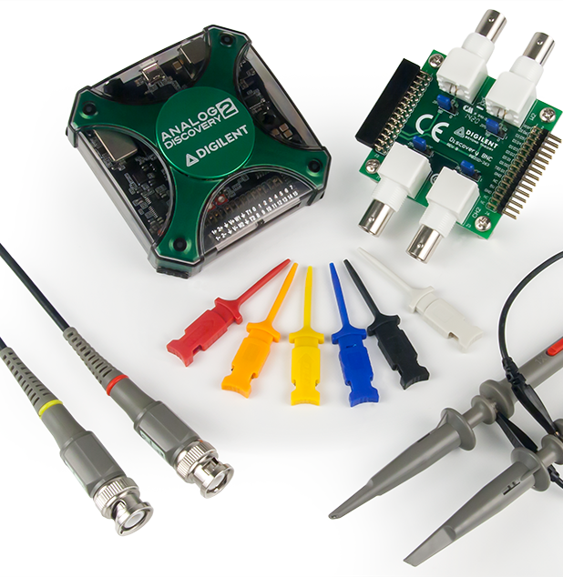
Project Summary
Problem Statement
Access to an affordable, course-specific solution for distance-learning students to complete ECEN 215 Labs is minimal
Our Solution
An affordable, self-contained system that enables hands-on measurements and intuitive data displays
AD2 Kit: $400
Notes:
Eric

Slide 3
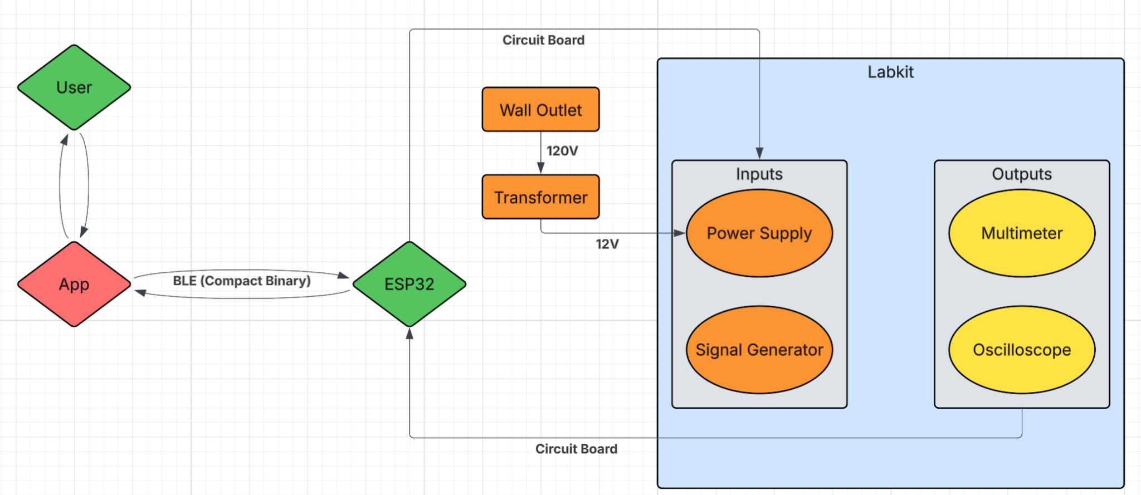
Project/Subsystem Overview
PCB
Software
Subsystem | Responsibility
Power Supply | Gavin Bernard
Signal Generator | Gavin Bernard
Mobile Application | Evan Slyter
Multimeter | Maylun Huang
Oscilloscope | Maylun Huang
Notes:
Eric

Slide 4
Major Project Changes for 404
No changes have been made
Notes:
Eric

Slide 5
Project Timeline
1/26 | 2/9 | 2/23 | 3/9 | 3/23 | 4/20
Validate subsystems PCB integration Labkit BLE output seen by app | Finalize PCB design and order Start coding | Fully soldered PCB App integration started | Integration complete Debugging and testing | Final Validation | Final Demo
Notes:
Eric

Slide 6
Power Supply/Signal Generator
Gavin Bernard
Accomplishments since 403 10 hrs of effort | Ongoing progress/problems and plans until the next presentation
Redesign for constant voltage High current testing | Combine to one PCB Connect the signal generator and the varied voltage to app

Slide 7
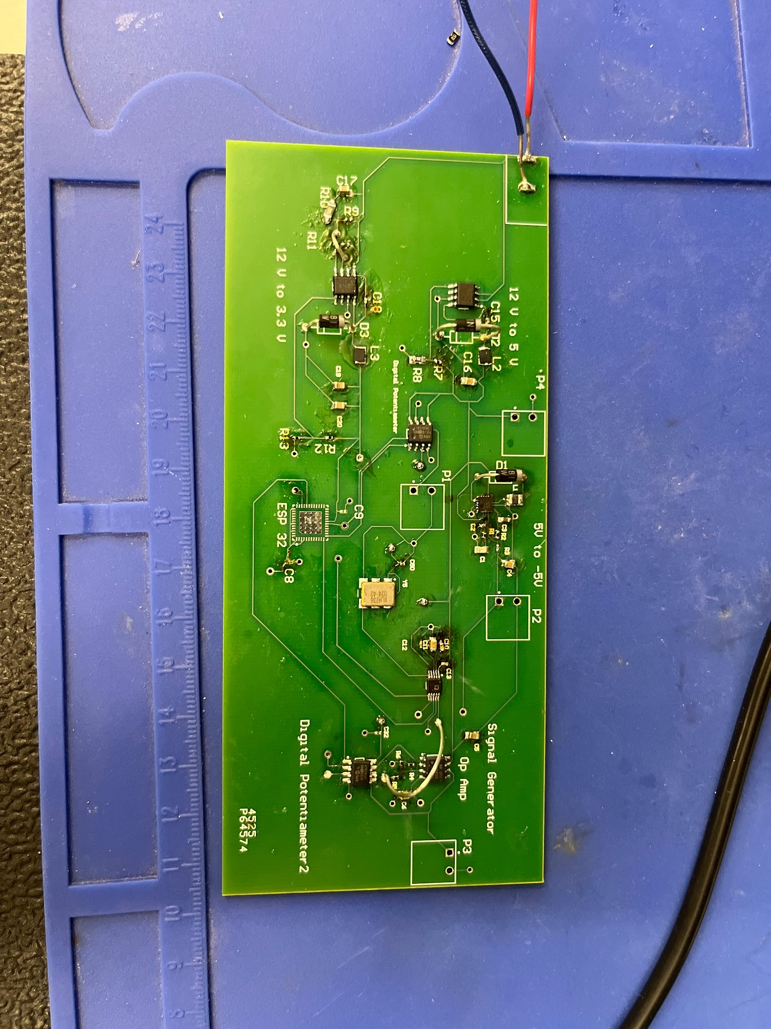
Power Supply/Signal Generator
Gavin Bernard
Removal of Jumper Cables
Integrated ESP 32
Adjust the Signal Generator to reach edge cases
More compact design for constant outputs

Slide 8
Measurement Subsystem
Maylun Huang
Accomplishments since 403 6 hrs of effort | Ongoing progress/problems and plans until the next presentation
Validated multimeter results Adjusted ohmmeter to better suit measurement ranges | Combine PCB design with Power Generation subsystem

Slide 9
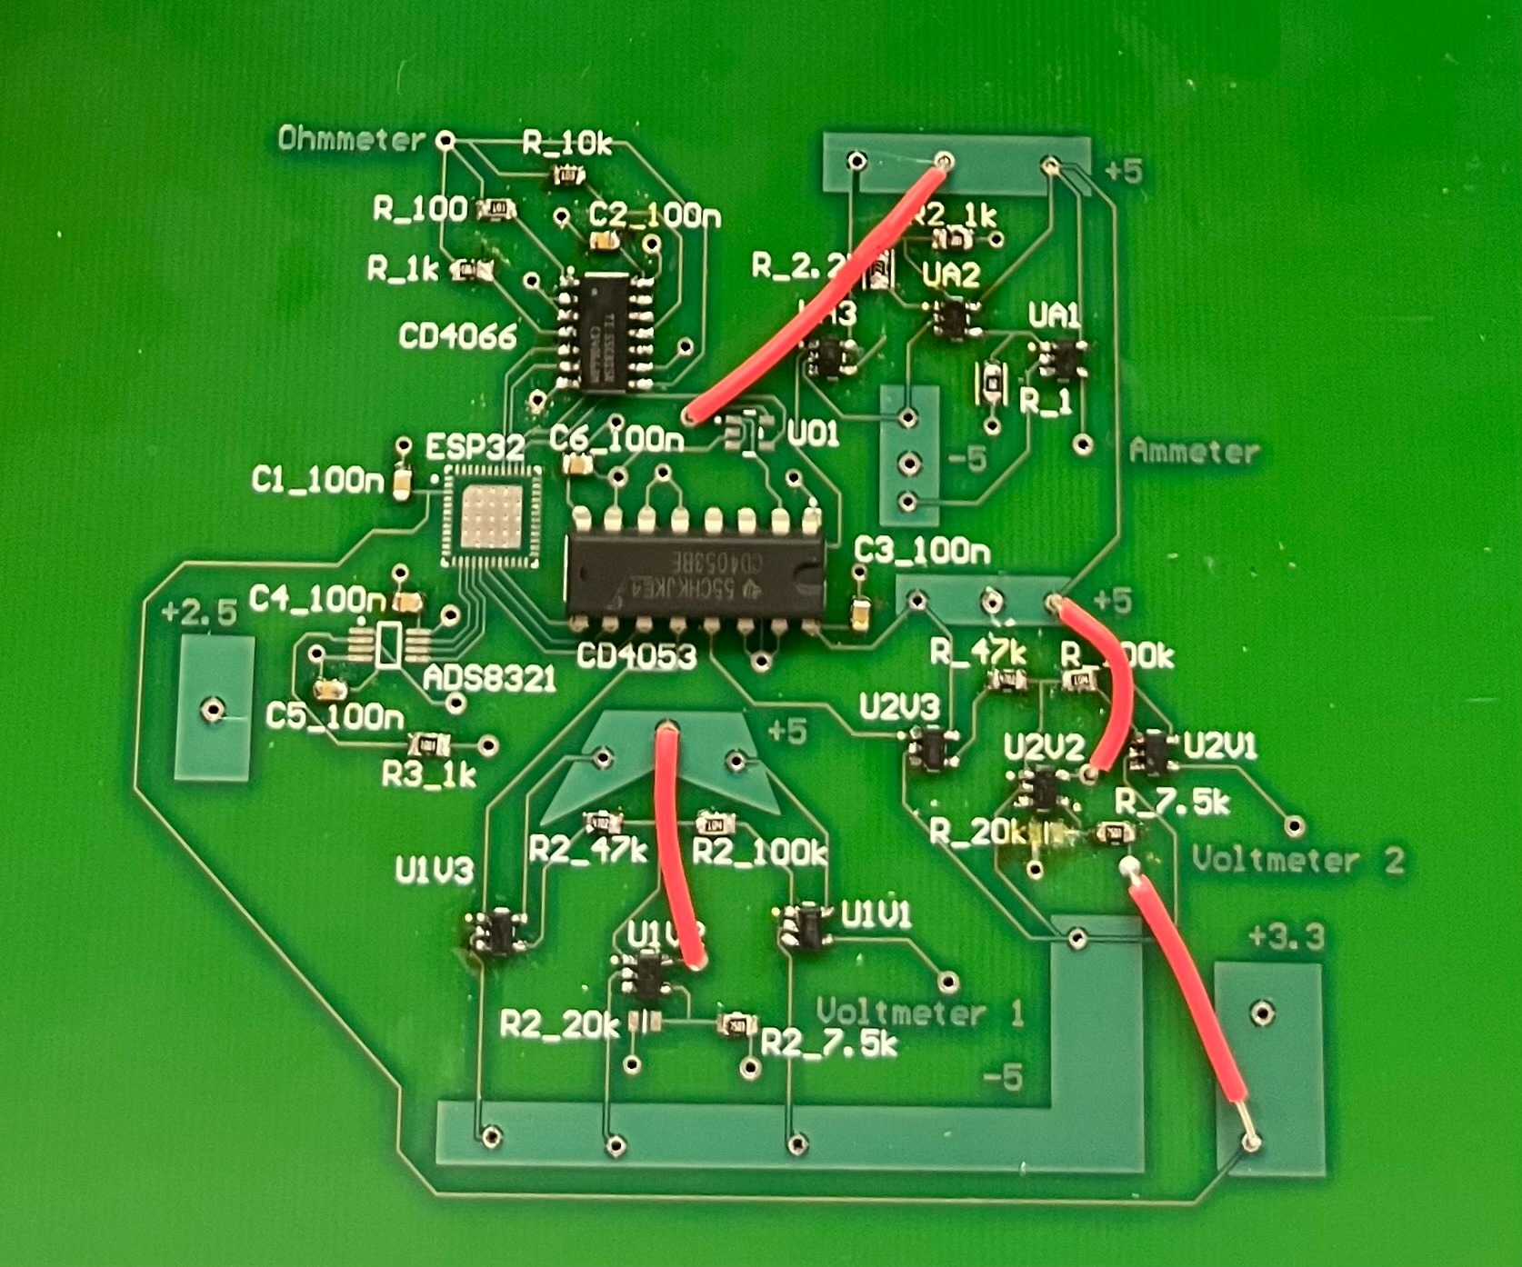
Measurement Subsystem
Maylun Huang
Validated PCB
Adjusting ammeter to measure larger range
Adjusting layout to remove polygons and jumper wires
MCU transition from dev-kit to PCB

Slide 10
Mobile App
Evan Slyter
Accomplishments since 403 4 hrs of effort | Ongoing progress/problems and plans until the next presentation
Ensured app is still in same condition as 403 | Use BLE output from other device and receive data on app Modeling main body of labkit

Slide 11
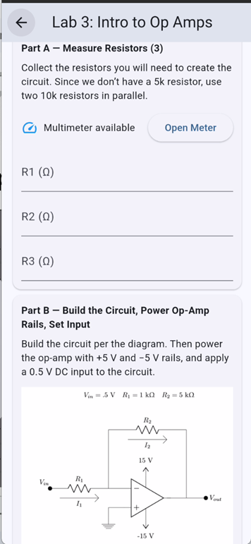
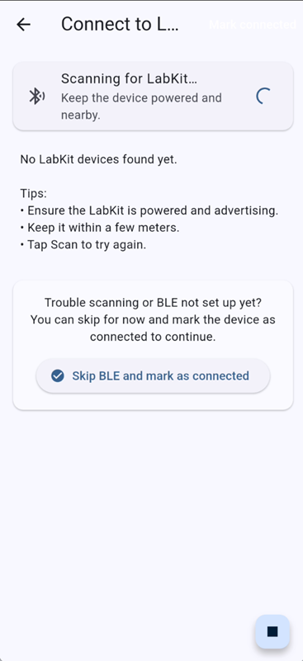
Mobile App
Evan Slyter
-Labs fully implemented
-BLE scanning in progress

Slide 12
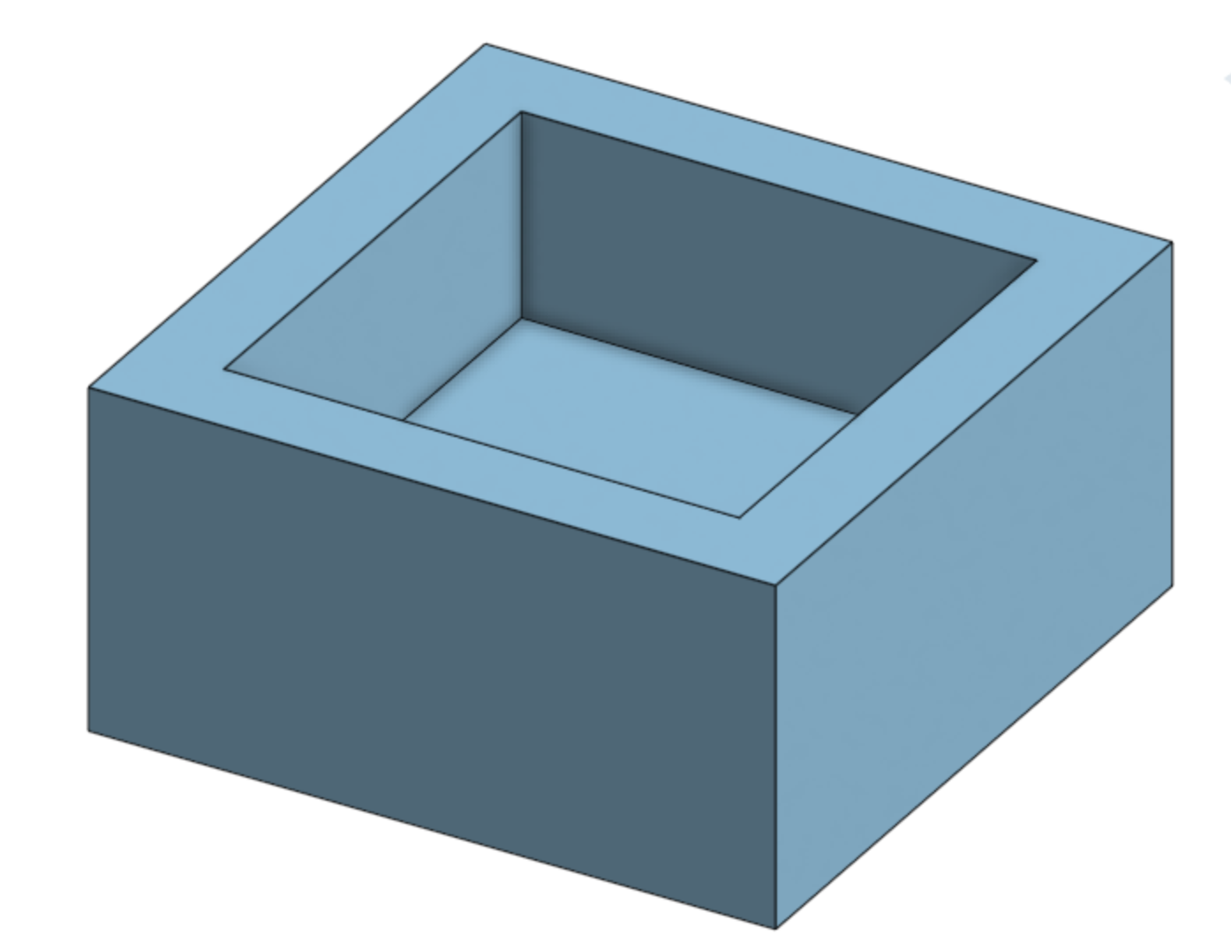
3D Model
Evan Slyter
-Basic model
-Dimensions needed from PCB
-Undecided if sealed/openable

Slide 13
Parts Ordering Status
Final PCB & components remain to be ordered
Notes:
Michelle

Slide 14
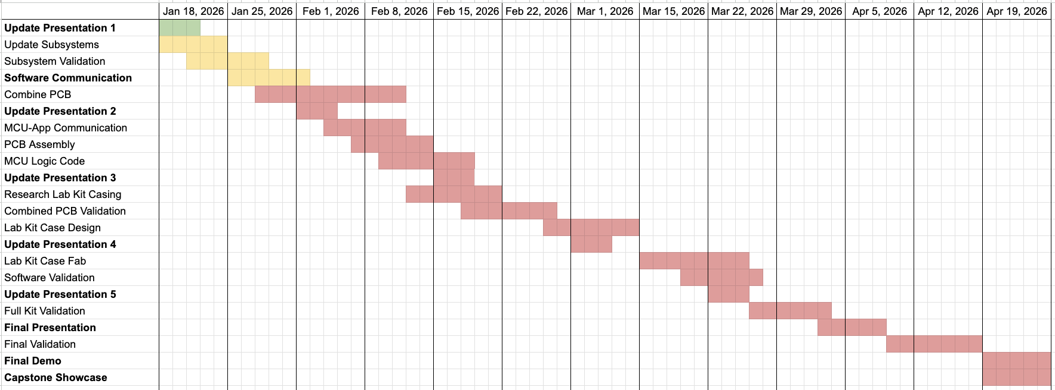
Execution & Plan
Notes:
Execution plan
Your team planned milestones for completion of any remainingsubsystem functionality, integration of specific subsystems,test, and validation plans should be presented.
Milestones should have owners … things like final integrationcan be group owned
Gantt chart – should indicate some 404 progress.
Try to complete all subsystem function in next 3 weeks.
Try to complete all integration 2 weeks before demo to allowfor system validation and documentation

Slide 15
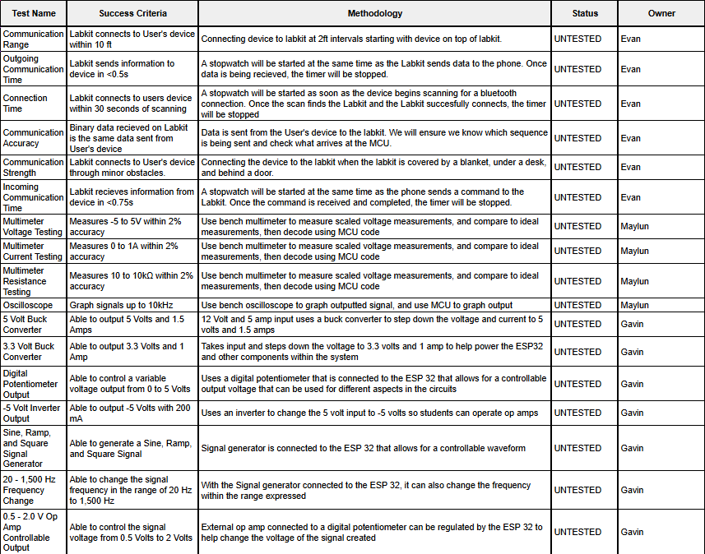
Validation
Notes:
Execution plan
Your team planned milestones for completion of any remainingsubsystem functionality, integration of specific subsystems,test, and validation plans should be presented.
Milestones should have owners … things like final integrationcan be group owned
Gantt chart – should indicate some 404 progress.
Try to complete all subsystem function in next 3 weeks.
Try to complete all integration 2 weeks before demo to allowfor system validation and documentation

Slide 16
Questions?

